Slide 1
PSSA
Concussion
"Concussion usually results from a blow or knock to the head, but it can also occur from a knock or a blow to anywhere in the body."
David hughes, AIS chief medical officer
IF IN DOUBT, SIT THEM OUT!
Notes:
School Sport Unit is at Bankstown and is there to assist schools in situations that they may encounter. Head of School Sport is Mr Ross Morrison and each region has a Regional Sports Organiser. SE SS RSO is Mr Bruce Riley.

Slide 2
Topics
1 Introduction
2 Incidence
3 What is Concussion?
4 Concussion in children
5 Recognising
6 Remove and Refer
7 Return to learn and play
8 Under reporting is still a problem
9 REMEMBER: Keep children safe at school sport
Banned Activities and Staff Ratios

Slide 3
1 Introduction
‘Sport-related concussion is a growing health concern in Australia’
(Elkington et al, 2018)
Concussion in Sport Australia Position Statement (Elkington et al, 2018) - evidence based information - safety and welfare of Australians participating in sports - update in 2018 includes comprehensive information of concussion in children - targeted education key to improving awareness and understanding in the community
https://concussioninsport.gov.au/home

Slide 4
2 Incidence
Rates of concussion are increasing
Sports with highest concussion rates (per 100,000 participants) • Motor sports 181 • Equestrian 130 • Australian Football 80 • Rugby (all codes) 50
(Finch et al, 2013)
Incidence of concussion is higher in children than any other age group.

Slide 5
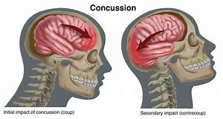
3 What is concussion?
Traumatic brain injury
Disturbance in brain function caused by direct or indirect force to the head
Short lived impairment of neurological function
Evolving injury
Symptoms usually resolve themselves within 14 days
Main treatment is rest followed by a gradual return to activity

Slide 6
4 Concussion in children
Special considerations for children
• Physical and developmental differences
• Greater susceptibility to concussion
• Take longer to recover
• Risk of more severe consequences
Management requires different standards to adults and a more conservative approach.

Slide 7

5 Recognising
If athlete is displaying any of the following they should be immediately removed from sport and first aid principles followed: If no recognised health care professional available
CALL AN AMBULANCE INFORM PRINCIPAL
Call Incident and Support Hotline 1800 811 523
Loss of conscious or deteriorating conscious state
- Neck pain or tenderness
Double vision
- Weakness or tingling/burning in arms or legs
- Severe or increasing headaches
- Seizures or convulsions
- Vomiting
- Increasingly restless, agitated or combative

Slide 8
Observable Signs
Lying unconsciousness
Slow to get up after a direct or indirect hit to the head
Disorientation or confusion
Inability to respond appropriately to questions
Blank or vacant look
Balance difficulties, uncoordinated movements, stumbling or slow laboured movements
Face or head injury

Slide 9
PHYSICAL
- Headaches
- Balance problems
- Nausea or vomiting
- “Pressure in head”
- Dizziness
- Blurred vision
- Sensitivity to light and noise
- Neck pain
EMOTIONAL OR BEHAVIOURAL
- Fatigue or low energy
- Sadness
- Nervous or anxious
- More emotional
- More irritable
MENTAL OR COGNITIVE
- Fogginess or difficulty thinking
- Feeling slowed down
- Difficulty concentrating or remembering
SLEEP
- Sleeping more or less than usual
- Difficulty falling asleep or staying awake
SYMPTOMS

Slide 10
MEMORY ASSESSMENT
• What is your name?
What school do you attend?
What sport are you playing?
What venue are we at today?
• Which half is it now?
• What team are you playing?
Who is your teacher with you here today?
How did you travel to the venue?
Ask Appropriate Questions per age

Slide 11
6 REMOVE AND REFER
If any of the signs are present, the athlete reports any of the symptoms or answers any questions incorrectly;
• they must be removed from the activity immediately
• they should not return to that activity until assessed by a medical practitioner
School /Cronulla PSSA Head Injury Recognition and Referral Form to be completed and given to Parent/ Care giver along with Cronulla PSSA Head Injury Factsheet

Slide 12
PSSA Head Injury Fact Sheet
Head Injury Factsheet
Name: ____________________ School:______________________
You have been given this information as you have received a blow to the head or body.
Concussion is a mild brain injury and is a disturbance in brain function rather than a structural injury that can be caused by a direct or indirect force to the head, neck or face or elsewhere on the body that transmits a force to the head.
Concussion signs and symptoms may occur immediately or may emerge up to 48 hours after the impact, therefore it is important that the athlete be monitored for a minimum of 24 hours.
Concussion should be suspected if one or more of the following emerge and the athlete will need to be assessed by a medical doctor and cleared to return to school/sport under medical advice;
Disorientation, confusion
Pale
Fatigue
Sensitivity to light/noise
Memory impairment
Nausea
Difficulty concentrating
Headache or ‘pressure in the head’
Feeling slowed or ‘not right’
Dazed, blank/vacant stare
Behavior or emotional changes, not themselves
If any of the below occur, immediate referral to an emergency department is required;
Neck pain
Increasing confusion agitation or irritability
Repeated vomiting
Seizure or convulsion
Weakness or tingling/burning in the arms or legs
Deteriorating conscious state
Severe or increasing headache
Unusual behavioral change
Visual or hearing disturbance
For the next 24 hours;
Rest quietly
Do not be left alone
Do not swim alone
Do not take anti-inflammatory or pain killer medication unless instructed by your doctor

Slide 13
School Sport PSSA Head Injury Recognition and Referral Form

Slide 14
Medical Assessment Clearance

Slide 15
6 REMOVE AND REFER
Any observable head knocks, even if no other signs or symptoms present:
• the athlete must be removed from the activity
• not allowed to return to that activity that day
• Parent/Care giver to be given Head Injury Factsheet
School Sport protocols for Concussion Management :
• Concussion assessment
• Mandatory 24 hour rest
• Reassessed before returning to activity
• Continuous monitoring for further 24 hours
Any appearance of signs or symptoms of concussion refer for medical assessment

Slide 16
REST
Once diagnosis is confirmed the main treatment for concussion is rest followed by a gradual return to activity.
Evidence supports a lower rate of recovery in children and adolescents 18 and under
(Elkington et al, 2017)
Recommendation for children is 48 hours rest
Includes physical and cognitive rest
- No Television, computer games, school etc.

Slide 17
IF IN DOUBT, SIT THEM OUT!
Children 18 years or under - No return to contact/collision
activities before 14 days from complete resolution of all concussion symptoms

Slide 18
7 Return to Learn and Play
Return to learn takes priority over return to play!
Daily activities while remaining symptom free – work/school
2. Light aerobic exercise – walking, swimming or stationary cycle at a slow to medium pace
3. Sport-specific exercise – running drills, no activities with head impact
4. Non-contact training drills – harder training drills, start progressive strength or weight training
AFTER RECEIVING MEDICAL CLEARANCE
5. Full contact training – normal training activities
6. Return to play

Slide 19
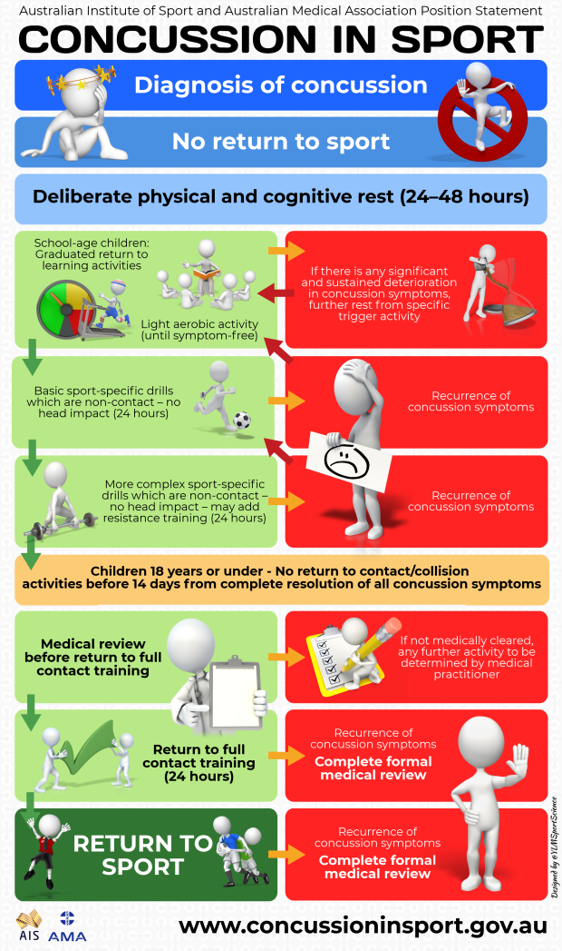

Slide 20
8 Under Reporting is a Problem
Parents and teachers need to have a good understanding of concussion in order to appreciate the importance of identifying symptoms and supporting athletes during recovery and as they return to sport. Parents and teachers must be able to recognise the symptoms and signs of concussion in order to detect concussion when no medical supervision is present.
Athletes need to have a good understanding of concussion in order to appreciate the importance of reporting symptoms and complying with rest and return to sport advice.

Slide 21
9 Keep children safe at school sport
Remember Banned Activities at School Sport
Requirements for All Sport and Physical Activity should be consulted on https://app.education.nsw.gov.au/sport/page/1114
Banned Activities
Some activities are banned for inclusion in school sports and physical activity programs. The following activities must not be undertaken (*this is not an exhaustive list):
Bungee Jumping
Rock Fishing
Tobogganing
Break Dancing
Hang Gliding
Rodeo
Boxing
Note some sports require specific teacher training to undertake the activity with students and must be Principal endorsed (gymnastics, martial arts, cycling, rugby league, bushwalking, golf *this is not an exhaustive list)

Slide 22
9 Staff/Student Ratio
In general, the teacher to student ratio for scheduled sport activities should not exceed 1:30. However, a significant number of sporting activities, particularly aquatic and outdoor recreation activities, have specific teacher/instructor to student ratios. Where relevant this information has been noted in the SPORT SAFETY Guidelines.
At the discretion of the principal, the number of supervising teachers, at times, will be greater than in the stated ratio because of:
the age, experience or capabilities of the students
maturity of the participants
the combined experience or expertise of the staff
the nature of the area in which the activity is to be conducted
the nature of the activity
method of travel
experience and qualifications of the adult supervisors.
Any activity involving swimming or water activities and/or overnight stay is to be accompanied by a member of staff who possesses current training in cardio-pulmonary resuscitation.

Slide 23
Sporting Organisation Guidelines on concussion
Sporting organisations in Australia have responded to the increased concern regarding concussion. The four major football codes have introduced rule changes in recent years to ensure more thorough clinical assessment of the athlete with suspected concussion and to enforce guidelines around management of the concussed athlete.
Australian Football League aflcommunityclub.com.au/index.php?id=66
• National Rugby League
https://playnrl.com/media/2604/the-management-of-concussion-in-rugby-league-final.pdf
• Basketball Australia
http://www.basketball.net.au/wp-content/uploads/2014/05/Concussion-Guideline.pdf
• Football Federation Australia https://www.ffa.com.au/sites/ffa/files/2018-01/18-0102%20FFA%20Concussion%20Guidelines%20%28final%29.pdf?_ ga=2.113230029.818472769.1533772800-1702376216.1531715461
Netball Australia
https://s3-ap-southeast-2.amazonaws.com/netball-wp-assets/wp-content/uploads/2018/08/27112251/Concussion-Policy_FINAL-02.04.183.pdf

